Slide 1
Sounder products for Weather and Climate applications
Second Suomi-NPP Applications Workshop
Thursday, Nov. 20, 2014, 9:00 am
Chris Barnet
With lots of help:
NUCAPS product graphics: Colby Francoeur (STC summer intern)
Direct Broadcast Implementation: Thomas King and Letitia Soulliard (STAR), James
Davies and Liam Gumley (CIMSS)
CalWater-2 Field Campaign: Ryan Spackman (STC)
NUCAPS AWIPS Initiative: Bill Sjoberg and Brian Motta (NOAA)
Notes:
20 minutes total

Slide 2
Discussion Points
Quick overview of NOAA-Unique CrIS/ATMS Processing System (NUCAPS)
Status of Direct Broadcast implementation
NOAA Sounding Initiative Activities
Improvements to AWIPS-II implementation
Cold Air Aloft Initiative
CalWater 2 Campaign, Jan/Feb 2015
NASA Suomi-NPP Sounding discipline activities

Slide 3
NOAA-Unique CrIS/ATMS Processing System (NUCAPS)
NUCAPS was designed to be instrument independent
Namelists point to files that specify instrument
Avoid hardwiring of any instrument specifics
The NUCAPS science code was derived from the AIRS multi-author Science Team (AST) science code
The same science code was also used for the NOAA operational Metop (IASI, AMSU, MHS, AVHRR) system.
Science code is easily configurable for these datasets
Science code can be configured to run AIRS or IASI
Can be used for simulation of hypothetical instruments
Can mix and match sensors (e.g., Aqua AIRS + NPP ATMS)

Slide 4
What makes this algorithm unique?
Designed to use all available sounding instruments.
Climatological startup.
Only ancillary information used is surface pressure from GFS
Microwave radiances used in microwave-only physical retrieval, “cloudy” regression, “cloud cleared” regression and downstream physical T(p) and q(p) steps.
Use a comparison of 4 independent retrieval steps for quality control (QC) in addition to traditional QC (residuals, etc.).
Utilizes the high-information content of the hyper-spectral infrared – both radiances and physics.
All channels used in constrained regression first guesses.
Utilize forward model derivatives help constrain the solution.
Physical steps use full off-diagonal covariance of (obs-calc) errors.
Minimizes arbitrary a-priori constraints.

Slide 5
Summary of products from NUCAPS Algorithm (in AWIPS-II)
gas | Range (cm⁻¹) | Precision | d.o.f. | Interfering Gases | Sensitivity
T | 650-800 2375-2395 | 1.5K/km | 6-10 | H2O,O3,N2O emissivity | surface to ~1 mb
H₂O | 1200-1600 | 15% | 4-6 | CH4, HNO3 | surf to 300 mb
Cloud P, T, fraction | 700-900 | 25 mbar, 1.5K, 5% | ≈2 | CO2, H2O | surface to tropopause
O₃ | 1025-1050 | 10% | 1+ | H2O,emissivity | Lower strat.
CO | 2080-2200 | 15% | ≈ 1 | H2O,N2O | Mid-trop
CH₄ | 1250-1370 | 1.5% | ≈ 1 | H2O,HNO3,N2O | Mid-trop
CO₂ | 680-795 2375-2395 | 0.5% | ≈ 1 | H2O,O3 T(p) | Mid-trop
Volcanic SO₂ | 1340-1380 | 50% ?? | < 1 | H2O,HNO3 | flag
HNO₃ | 860-920 1320-1330 | 50% ?? | < 1 | emissivity H2O,CH4,N2O | Upper trop
N₂O | 1250-1315 2180-2250 | 5% ?? | < 1 | H2O H2O,CO | Mid-trop
Notes:
NH3 = 7.5*BT(867.75)/(BT(861.25)+BT(873.5)) mg/m^2
Clarisse, L., C. Clerbaux, F. Dentener, D. Hurtmans and P.F. Coheur
2009. Global ammonia distribution derived from infrared satellite
observations. Nature Geoscience v.2 p.479-483.
IASI products: http://www.class.ngdc.noaa.gov
HNO3: -1.4 K/100% at 879, -1.17K/100% at 1325.6
N2O: -0.44H/5% at 1300, -0.726K/5% at 2220.2
CFCl3(F11): 0.08/10% at 847
CF2Cl(F12): 0.124/10% at 922
SO2: -0.2K/1000% at 1345,1371 cm-1
CCl4: -0.026K/10% at 795

Slide 6
Status of Direct Broadcast (DB) Implementation of NUCAPS
NUCAPS is runnable on small unix/linux platforms
Operational preprocessor requires 4-scanset granules
read HDF5 ATMS and CrIS SDR and GEO files
co-locate ATMS and CrIS
compute surface altitude and land fraction from Digital Elevation Model
co-locate GFS forecast information
Surface pressure is used by retrieval (only external variable)
T(p), q(p), and O3(p) used for monitoring
Write NETCDF files for retrieval code
Retrieval code compatible with many versions of FORTRAN (e.g., GNU gfortran, Intel, Portland Group, and Absoft compilers)
Processing speeds are ~2x (i.e., 4 seconds for 8 second scanset) on a single CPU or 130 milli-second/retrieval

Slide 7
Chris Barnet report Oct. 29, 2014 NUCAPS Telecon
NUCAPS implementation into CSPP
Verified BD and NOAA-operations get same results
Full implementation is nearing completion this week
Expect a hiccup on Nov. 15, when CrIS goes into full-resolution mode
DB does not have FOV.4
IDPS, STAR, CLASS versions are unaffected, have all 9 FOVs
This should be resolved quickly and an upgrade will be delivered ASAP (most likely by Dec. 1)
Other upgrades include CF-compliant NETCDF
NUCAPS DB for pre- and post- CrIS modes should be available in Dec. 2014

Slide 8
NOAA/JPSS Satellite Application Team Initiatives for Sounding
NUCAPS has been implemented in AWIPS-II
This summer the JPSS Program Scientist selected Chris Barnet and Bill Sjoberg as co-facilitators of a sounding applications team
Primary goal is to promote new applications.
Also encourage interaction between developers and users
We currently have 4 active initiatives for sounding
AWIPS-NUCAPS training module and improvements
Aviation Weather Testbed (AWT) Initiative
Hydrometeorology Testbed (HMT) Initiative
Hazardous Weather Testbed (HWT) Initiative (in development, will take place in central USA region)

Slide 9
1) NUCAPS-AWIPS-II Training Initiative (POC is Brian Motta, NOAA)
Evaluate the current AWIPS implementation
NUCAPS locations are displayed on map, click to get skew-T plot
Quality control is absent – need to fix it
Also consider better QC – a “bad” retrieval might still be best there is
Consider changing file formats to enable:
Ability to plot soundings together with ACARS, radiosondes, etc.
And/or the ability to provide cross-section plots, comparison to models, etc.
Study cases where NUCAPS fails
Forecaster can submit interesting cases to a developer who can then study the case in detail, answer questions, and ultimately improve products.
Training
Enable forecasters to understand what information is – and is not – in the retrievals (e.g., using skew-T comparisons)
Enable developers to understand the needs of the forecasters

Slide 10
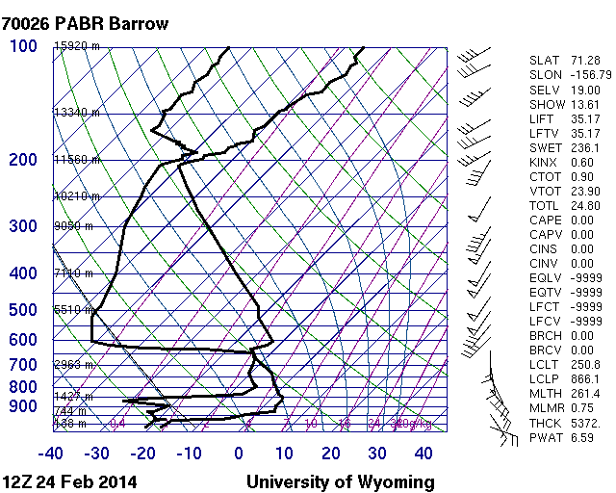
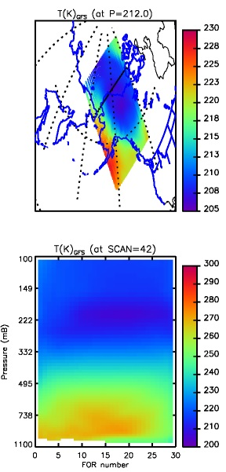
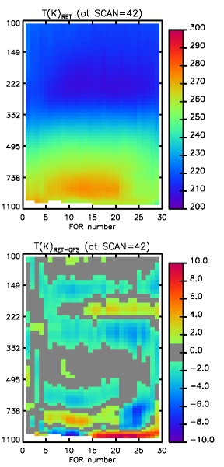
2) Aviation Weather Testbed initiative (POC is Brad Zavodsky, SPoRT)
Feb. 24 12Z sounding over Barrow Alaska
Skew-T provided by Eric Stevens, GINA
Airline fuel begins to freeze below -65 degC, need to issue pilot advisories
Forecasters need to know spatial and vertical location of “bubble” of cold air aloft
Currently have sparse data to rely on and little vertical information
Quickly ran NUCAPS for daytime (21Z) overpass
CrIS/ATMS easily see the cold air aloft in our cross-sections
Product has +/- 4 K differences f/GFS
Vertical location is different
Goal is to work with Alaska AWT/CWSU to develop visualization of cold air aloft and evaluated Suomi-NPP soundings in this context.

Slide 11
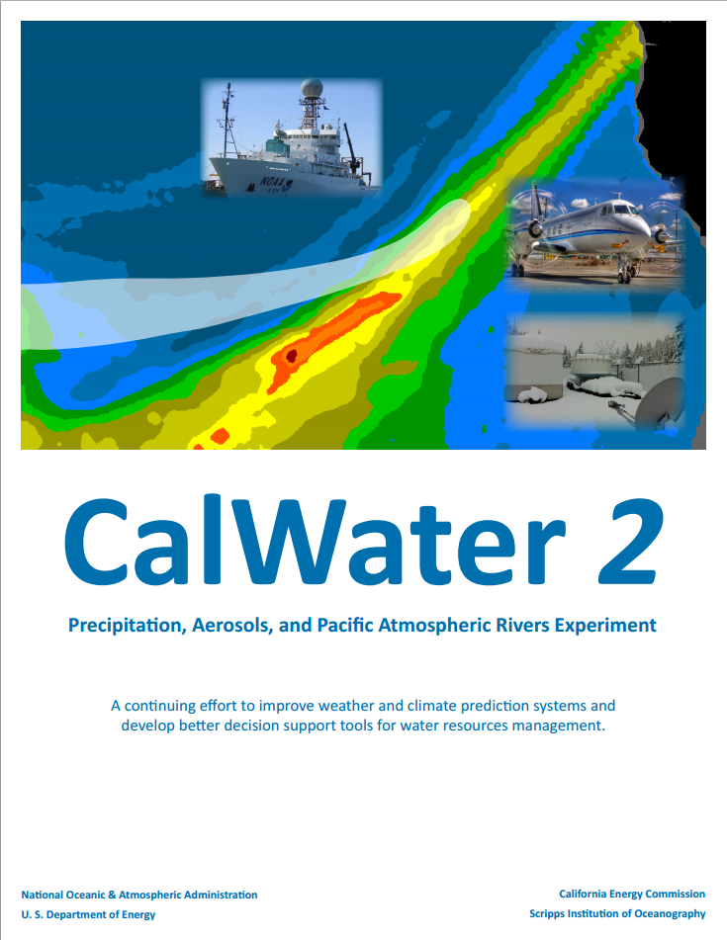
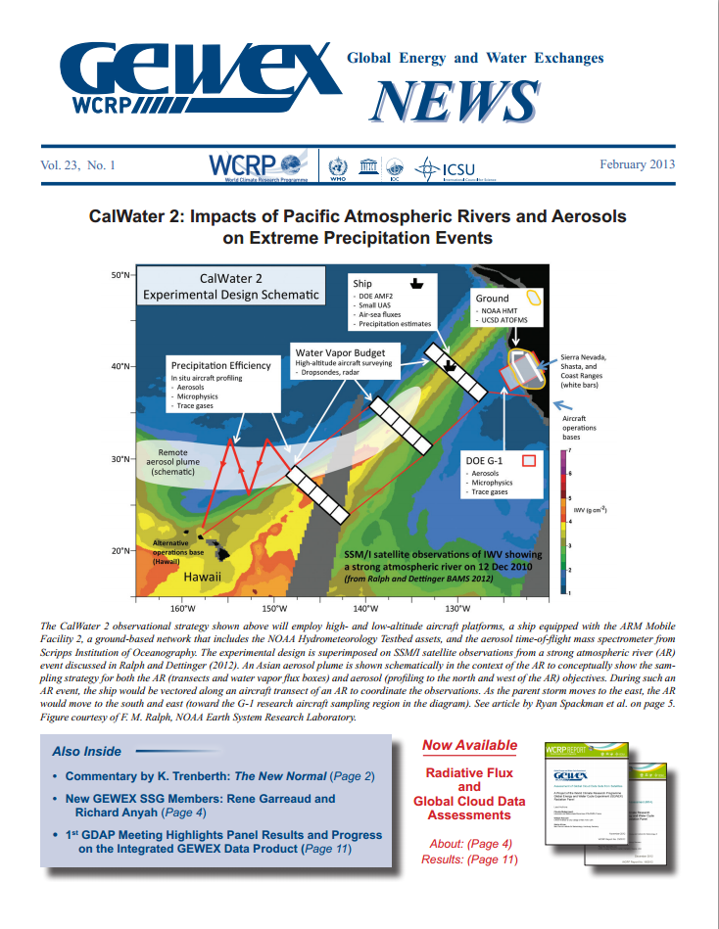
3) Hydrometeorology Testbed Initiative
(POC is Chris Barnet)
Participate in the CalWater 2 Field Campaign, Jan/Feb 2015
Focus is to improve forecasting of Atmospheric River (AR) events
CalWater 2 white paper is at http://esrl.noaa.gov/psd/calwater
PI is Marty Ralph, Scripps
Coordinated with DOE ACAPEX (ARM Cloud Aerosol Precipitation Experiment)
PI is L. Ruby Leung, DOE

Slide 12
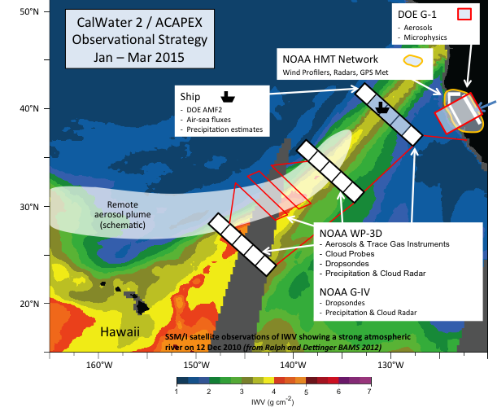
CalWater 2/ACAPEX Field Campaign
Interagency Campaign:
Scripps (Marty Ralph, Kim Prather)
NOAA (Allen White, Ryan Spackman)
DOE (PI: L. Ruby Leung) ARM Cloud Aerosol Precipitation Experiment (ACAPEX)
Platform | Range of Obs | Expected Duration | Types of sensors
AR Observatories and Hydro-Met Testbed | ARO sites: CA(4), OR(2), WA(1) | Full campaign | Snow level radar (S-band), 449 MHz wind profilers, soil moisture, 10 meter surface tower
NOAA WP-3D | 1-22 kft, 4000 km range | 80h over 4 weeks | ~150 dropsondes, W-band radar (clouds), IWRAP Radar, Tail Dopper Radar, Cloud Probes, SFMR
NOAA G-IV | 1-45 kft | 90h over 6 weeks | ~300 dropsondes, Tail Doppler Radar, NOAA O3, SFMR
DOE G-1 with ~40 instruments | 1-23 kft | 120h over 8 weeks | Cloud properties (Liq/water content, size), aerosol properties (concentration, size, CCN), trace gases (H2O, O3, CO)
NOAA R.H. Brown | Can move ≤ 5 deg/day to stay within AR | 30 days | AMF2: Aerosol Observing System, Ka ,X, W-Band Cloud Radars, DOE, Micropulse LIDAR, Wind Speed, Rain Guages RS-92 Sondes: ~260 (~half dedicated overpass time)

Slide 13
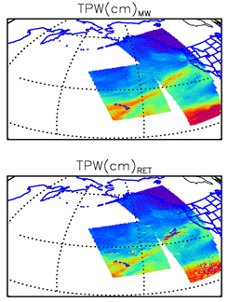
What can be done for CalWater 2
NRT NUCAPS products (T(p), IWV, q(p), O3(p), etc.) can be provided from the U.Wisc PEATE archive
This was done during CalWater-2 Early Start, in Feb. 2014, has ~8h latency
In January 2015 will have ~2 hour latency on PEATE
Also, there are now 3 to 4 direct broadcast sites that can provide CrIS/ATMS with ~15 minute latency
Each site acquires NPP CrIS/ATMS within a radius of ~500 km
Honolulu Hawaii, Corvallis Oregon, Fairbanks Alaska
NRL site recently came on-line
Sent flight planners figures of location of AR in NRT
Example below is Feb. 8, 2014 NRT product

Slide 14
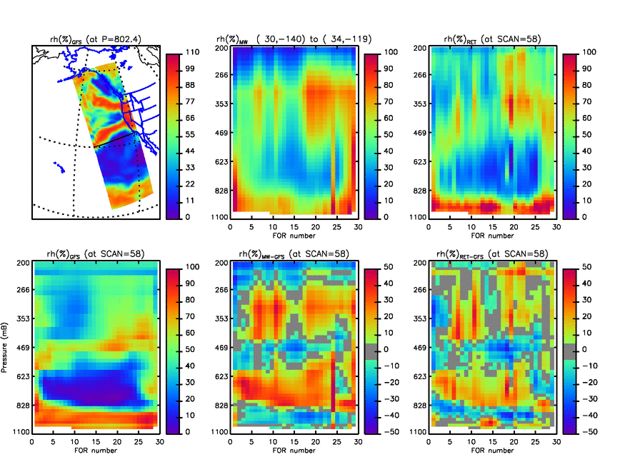
What these products provide to the CalWater field campaign
Satellite retrievals can provide synoptic-scale context for the sparse in-situ datasets
Retrievals can be used to characterize the regime outside the AR
(Most ret’s fail within AR due to heavy precipitation, will explore precip products)
ATMS-only
CrIS+ATMS
Comparison’s are made in NRT with GFS along vertical cross-sections
Post-analysis can be done w.r.t. ECMWF
Can evaluate research versions of code and QC

Slide 15
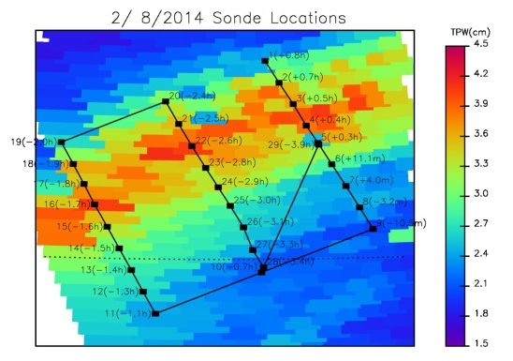
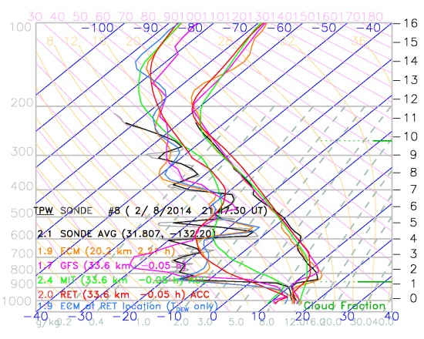
What we gain from CalWater 2
CalWater 2 is an opportunity for product validation
Test NUCAPS in extreme weather that is of national and societal interest
As algorithm developers, we need these kinds of scenes to improve the retrieval skill and tailor the quality control.
We can test experimental versions of NUCAPS
We gain the expertise of the entire CalWater science team to characterize the background environment.
Other in-situ measurements (CO, O₃, CO₂, aerosols) will help the NPP validation,
WFO’s have shown interest in NUCAPS products (via AWIPS-II)
Can demonstrate the value of NUCAPS in the field
an opportunity to work directly with WFO staff to understand their concerns
form the basis of relevant training modules
On Feb. 8, 2014 29 dropsondes were deployed in AR
Example skew-T of sonde #8, CrIS FOR #11 & models

Slide 16
NASA Suomi-NPP Science Team: Sounder Discipline

Slide 17
Suomi-NPP NASA Sounder Discipline Selection (August 2014)
PI Name | Company Name | Title
Aumann, Hartmut | Jet Propulsion Laboratory | Analysis of the AIRS and CrIS radiometric calibration under cloudy conditions and error propagation into environmental variables.
Barnet, Christopher | Science and Technology Corporation | Discipline Lead: Development and validation of a community hyper-spectral infrared microwave Earth retrieval algorithm: CHIMERA
Cady-Pereira, Karen | Atmospheric and Environmental Research, Inc. | Developing retrieval algorithms for NH3 and CO from NPP CrIS measurements using TES heritage algorithm
Lambrigtsen, Bjorn | Jet Propulsion Laboratory | Microwave sounder Earth System Data Records
Moncet, Jean-Luc | Atmospheric and Environmental Research, Inc. | Refined Atmosphere Data Products from CrIS and ATMS
Susskind, Joel | NASA Goddard Space Flight Center | Analysis of CrIS/ATMS using an AIRS Version 6-like retrieval algorithm

Slide 18
What are some guiding principles of a climate product for retrievals?
Requires reprocessing of full dataset
By extension, this implies (to me) that AIRS/AMSU and CrIS/ATMS have same spectroscopy and retrieval method
Alternatively we could make the radiances look the same
IASI/AMSU/MHS in the future (next call?)
Incorporate MODIS, AVHRR, and VIIRS in the future
Community accepted error estimates and/or product characterization (a.k.a., averaging kernels)
Requires formal error covariance of the a-priori
… and formal error covariance of the final products.
A well characterized a-priori suitable for a multi-instrument time series
Notes:
https://www.wmo.int/pages/prog/gcos/documents/gruanmanuals/WCP_WCDMP/WCDMP-52_000.pdf

Slide 19
We propose to use the NUCAPS Science code as a baseline system
The significant difference from the weather version will be the choice of the a-priori
Want an a-priori that contributes unique information in low information content domains.
Want an a-priori that the climate community considers to be well behaved and understood
Prior for trace gases will be simple climatologies
Except ozone, where we will use tropopause relative climatology (Wei 2010 JAOT v.27 p.1123)
Prior information for T/q | Pro/Con
Climatology | Simple and constant, retrieval skill is
Microwave only O-E w/ clim | With ATMS has high IC, but not Aqua/AMSU
NCEP Reanalysis | R1 (w/o satellite), f(time) for others
ERA-Interim | System changes with time, good q(p)
MERRA-2 | Consistent reprocessing

Slide 20
Validation of climate products
"extraordinary claims require extraordinary evidence" Carl Sagan
We should avoid making algorithm choices using the same data sets used in “training” of algorithm or quality control components.
We should partition improvements into those from null-space and those from physical measurement concepts
Three tiers of validation:
Validation with independent in-situ (DOE-ARM, GPS, SHADOZ, MOSIAC, HIPPO etc.).
Verify performance w.r.t. known community reference networks (e.g., ENSO, PDO, AMO indices)
Verify short-term feedback terms reproduce published AIRS results (e.g., dq/dTs d{OLR}/dTs)

Slide 21
Questions?

Slide 22
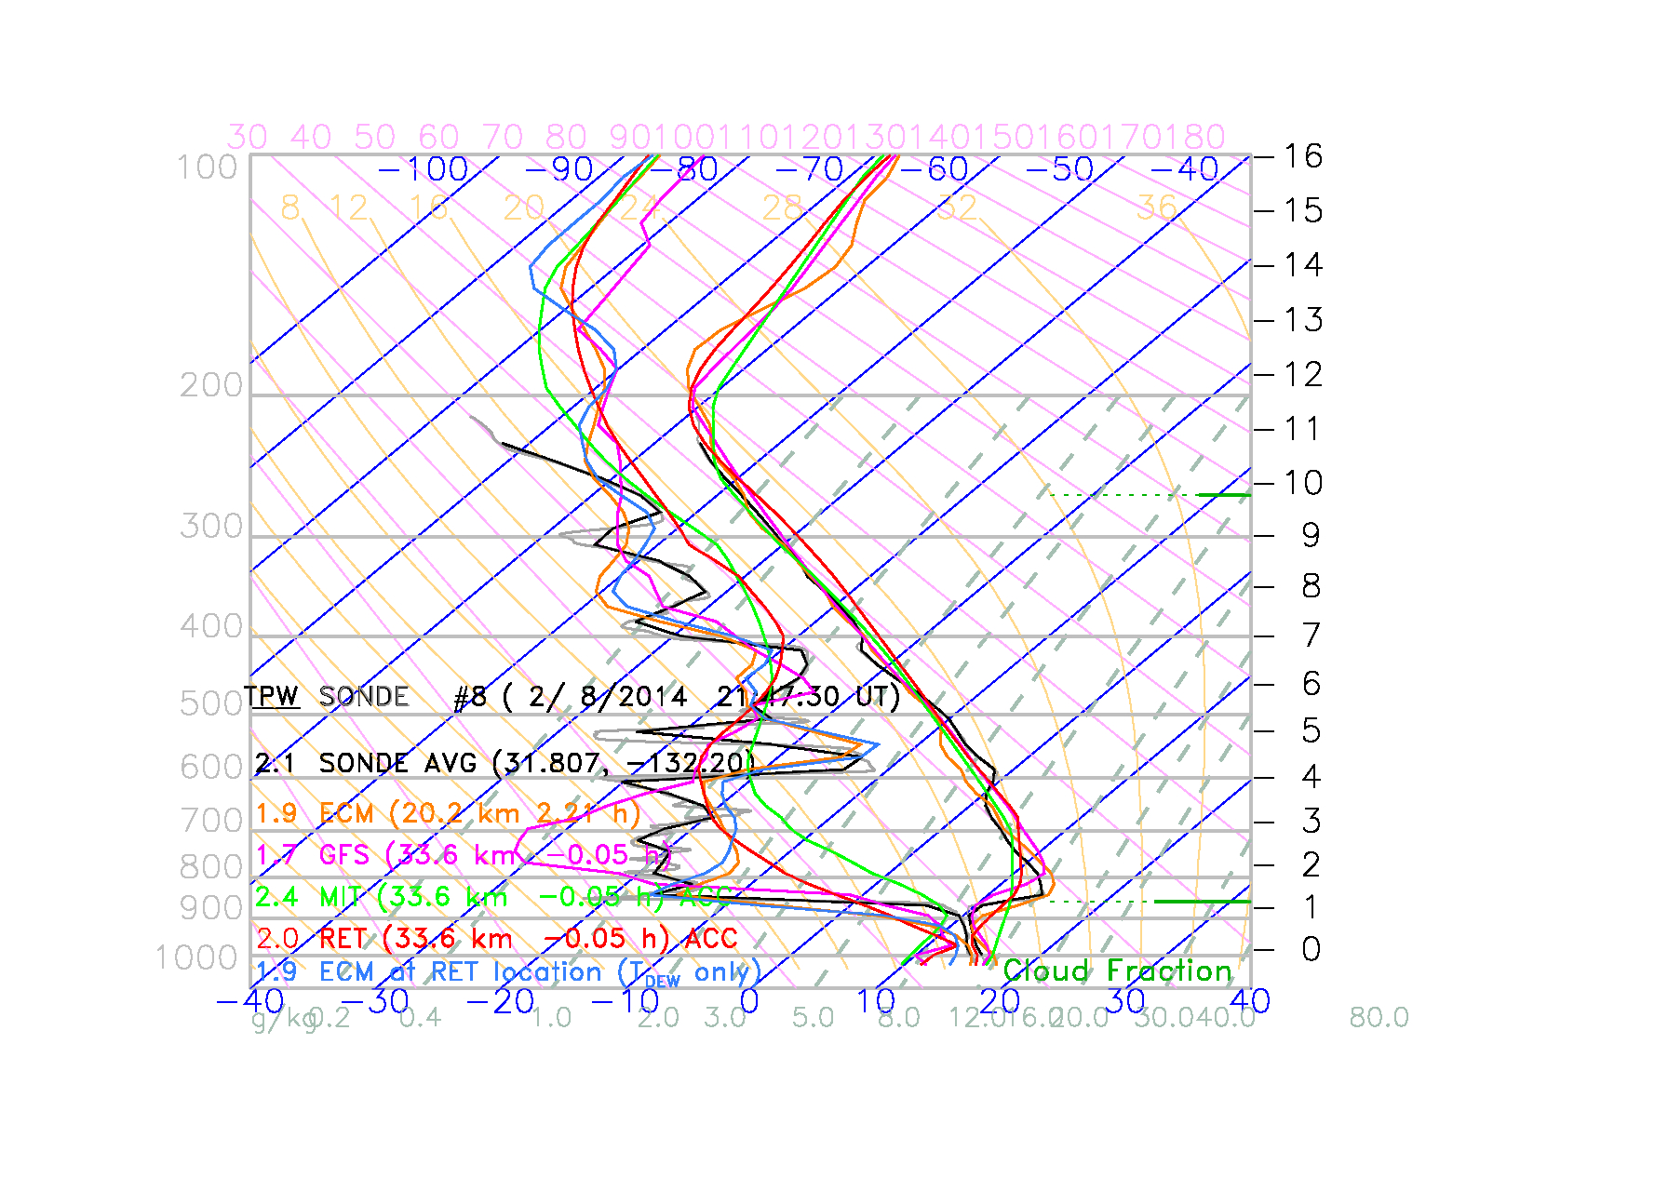
Comparison to dropsonde #8 (launched 3.8 min before satellite overpass)
Black = dropsonde (full-res and smoothed)
Cyan = GFS forecast interpolated to retrieval location
Green = uW-only retrieval
Red = IR+uW retrieval
This sonde was co-located at FOR #11 in the cross-section
Notes:
Sonde_plots_v3_skew/sonde_acc_140208_214730.jpg
;D20140208_213909_PQC.frd: ( 2/ 8/2014 21:47:30 UT) (31.807, -132.20)
;COLOR graphics are now redirected: PORTRAIT, ENCAPSULATED
;ECM: ifor= 11, iscan= 57 (g= 3 for= 1691) r= 20.16 km
;GFS: ifor= 11, iscan= 57 (g= 3 for= 1691) r= 33.65 km
;MIT: ifor= 11, iscan= 57 (g= 3 for= 1691) r= 33.65 km
;RET: ifor= 11, iscan= 57 (g= 3 for= 1691) r= 33.65 km
Closest is also accepted in this case

